Slide 1
Organizational Readiness and Cloud Change Management
(Unit-5)
by Dr. Rifaqat Ali
MITS, Madanapalle

Slide 2
Overview
Studies for Organization for Economic Co-operation and Development (OECD) economies in 2002 demonstrated that there is a Strong correlation between changes in organization and workplace practices and investment in ITs.
What is the best way to implement and manage change?
Why change is important and why change is complex, it also raises the question of :
managing emerging technologies and
the framework and approaches to assess the readiness of the organization to adopt.

Slide 3
Overview
Transition the organization to a desirable level of change management maturity level by enhancing the following key domain of knowledge and competencies:
Domain 1. Managing the Environment Understand the organization (people, process, and culture).
Domain 2. Recognizing and Analyzing the Trends (Business and Technology): Observe the key driver for changes.
Domain 3. Leading for Results: Assess organizational readiness and architect solution that delivers definite business values.

Slide 4
Organizational Readiness
FUD syndrome:
Fear, Uncertainty, and Doubt.
Management’s expectation from employees
Major changes introduces redesign or re-engineering the business process, change in required to the organizational structure and to specific jobs.

Slide 5
Organizational Readiness
Identify new training and skills requirements that support the new corporate goal and objectives.
Observable employee behavior when any change occurs
A recent study by IBM, “Making Change Work,” suggested that some 60% of projects fail to meet objectives; significant expense is incurred in terms of wasted money, lost opportunity, and lack of focus.

Slide 6
Organizational Readiness
A survey done by Forrester in June 2009 suggested that large enterprises are going to setup private clouds. The three reasons most often advanced for this are:
1. Protect Existing Investment: By building a private cloud to leverage existing infrastructure.
2. Manage Security Risk: Placing private cloud computing inside the company reduces some of the fear (e.g., data integrity and privacy issues) usually associated with public cloud.

Slide 7
A Case Study: Waiting in Line for a Special Concert Ticket
What is your reaction if tickets are sold out?
What should you do now without the tickets?
Do you need to change the plan?

Slide 8
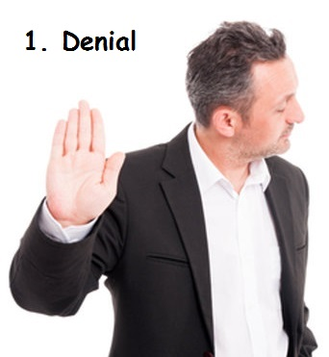
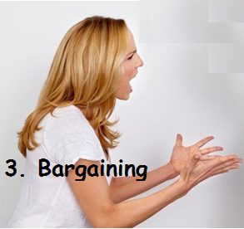

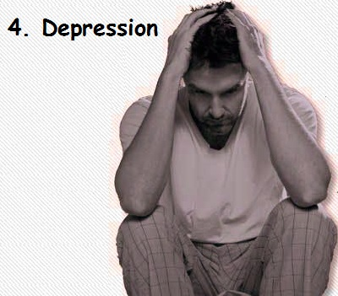
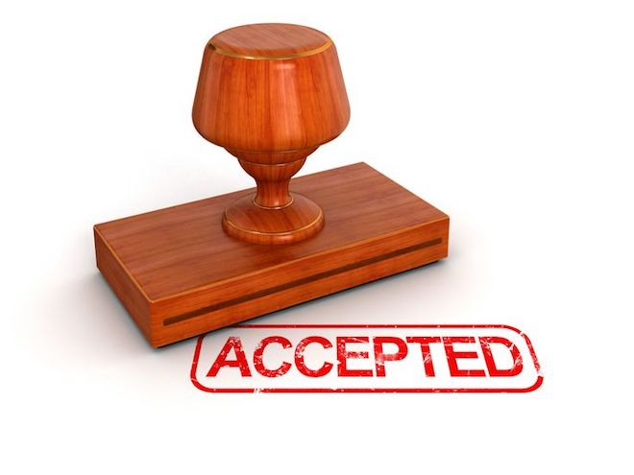

Slide 9
What do People Fear?
People are afraid of change.
People are also afraid of losing their position, power, benefits, or even their jobs in some instances.
Philosophy:
“No one ever got fired for buying technology from the industry leader measured by market size, and not necessarily decided on the amount of innovation produced.”

Slide 10
Cont…
The more common concerns are related to cloud computing, and some of them are truly legitimate and require further study, including:
Security and privacy protection
Loss of control (i.e., paradigm shift)
New model of vendor relationship management
More stringent contract negotiation and service-level agreement (SLA)
Availability of an executable exit strategy

Slide 11
Drivers for Changes
Five driving factors for change encapsulated by the framework are:
Economic (global and local, external and internal)
Legal, political, and regulatory compliance
Environmental (industry structure and trends)
Technology developments and innovation
Socio-cultural (markets and customers)

Slide 12
Common Change Management Models
More common models are:
Lewin’s Change Management Model
Deming Cycle (Plan, Do, Study, Act)
CROPS Change Management

Slide 13
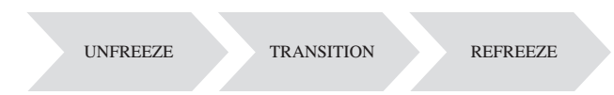
Lewin’s Change Management Model
Lewin observed three stages of change:
Unfreeze
Transition,
and Refreeze.

Slide 14
Lewin’s Change Management Model
Unfreeze:
People wish to remain in “safe/comfort” zone.
In order to encourage change, it’s necessary to unfreeze the environment by motivating people to accept the change.
Motivation for change must be generated before change can occur.

Slide 15
Lewin’s Change Management Model
Transition:
Change (plan) is executed and actual change is being implemented.
Activities take time to be completed.
The most resistance to change may be experienced during this transition period.

Slide 16
Lewin’s Change Management Model
Refreeze.
Stage when the organization once again becomes unchanging/frozen until the next time a change is initiated

Slide 17
Deming Cycle Model
It is a continuous improvement model comprised of four sequential sub-processes:
Plan : Recognize an opportunity and plan a change
Do : Execute the plan in a small scale to prove the concept.
Check : Evaluate the performance of the change and report the results to sponsor.
Act: Decide on accepting the change and standardizing it as part of the process.
End of one complete pass (cycle) flows into the beginning of the next pass and thus supports the concept of continuous quality improvement.

Slide 18
Deming Cycle Model
Systems should be monitored, measured, and analyzed continuously to identify variations and substandard products and services.
Corrective actions can be taken to improve on the quality of the products or services delivered to the customers.

Slide 19
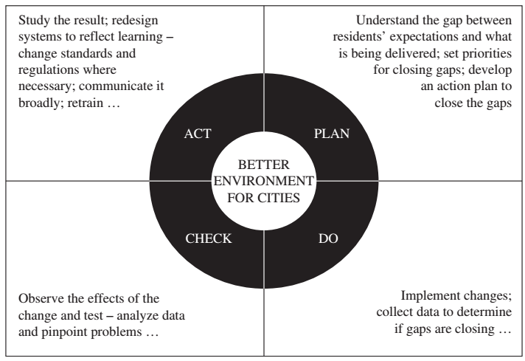

Slide 20
Summary
This part of unit 5 covers following topics:
Organizational Readiness
Cloud Change Management

